Slide 1

ANN , CNN, RNN,LSTM And GRU

Slide 2

Artificial Neural Network (ANN) is a computing model inspired by the human brain, using interconnected nodes to learn patterns and make predictions.

Slide 3
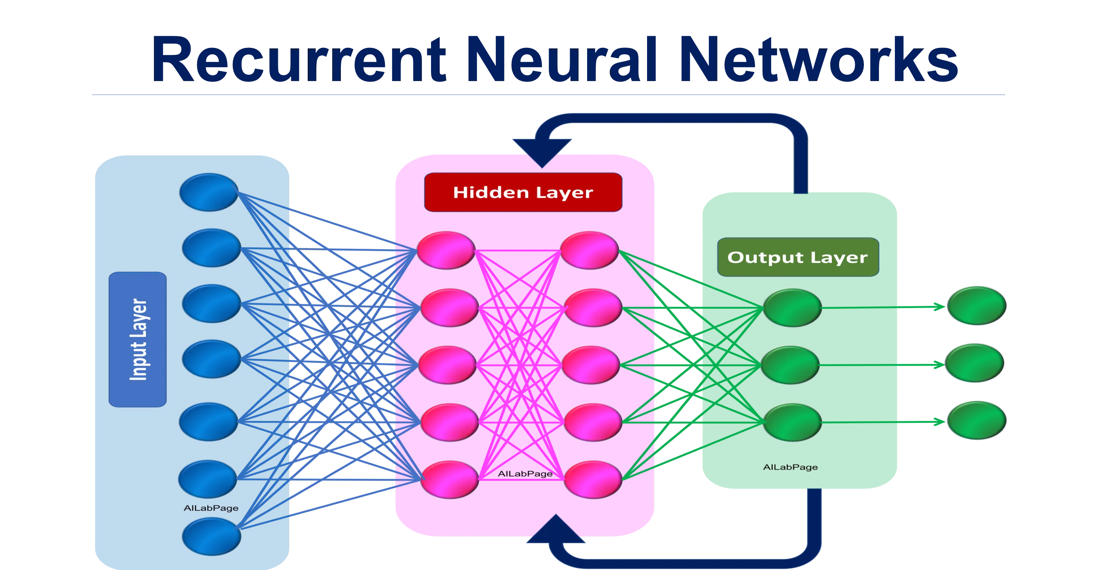
Recurrent Neural Network (RNN) is a type of neural network designed for sequential data, where past inputs influence future outputs, making it ideal for tasks like speech recognition and language modeling.

Slide 4
A Convolutional Neural Network (CNN) is a deep learning model designed for image processing, using convolutional layers to detect patterns and features like edges, shapes, and textures.

Slide 5
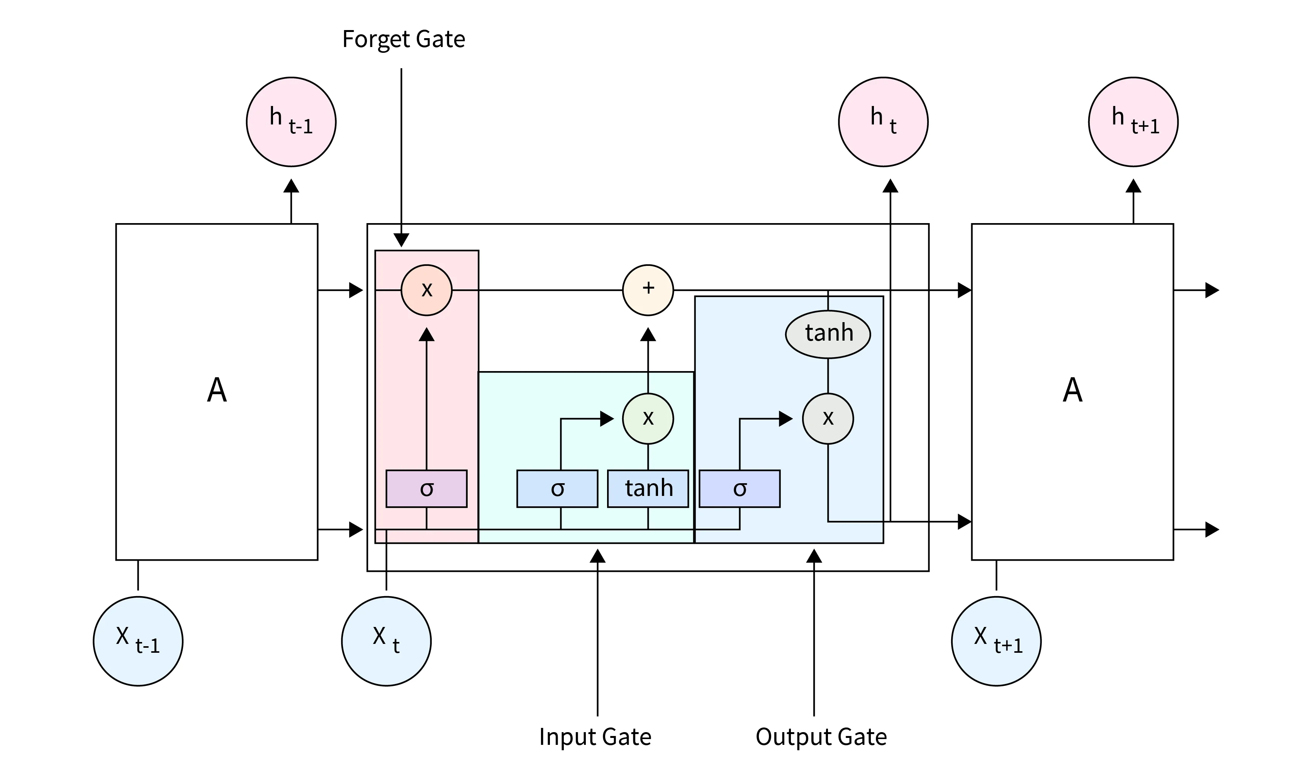
Long Short-Term Memory (LSTM) is a type of Recurrent Neural Network (RNN) designed to handle long-term dependencies by using memory cells, making it effective for tasks like speech recognition and time-series prediction.

Slide 6
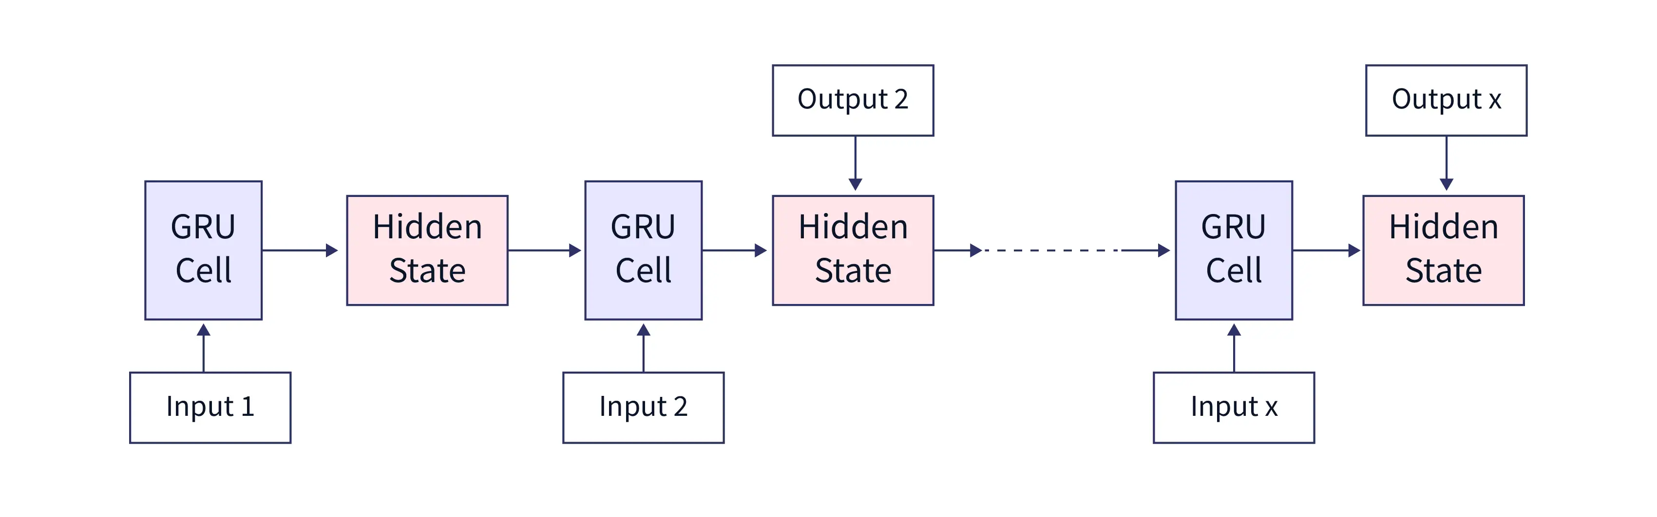
Gated Recurrent Unit (GRU) is a type of RNN that simplifies LSTM by using fewer gates, making it faster and more efficient for sequential tasks like speech recognition and text generation. It comprises three main components: an update gate, a reset gate, and a candidate hidden state.

Slide 7
Medium
How DeepSeek Revolutionized AI by Slashing Costs: A Deep Dive into Their Smart Techniques
- Explore how DeepSeek optimized GPU and CPU usage, introduced cost-efficient AI models, and set a new benchmark for generative AI development.
Building a Future with Generative AI: Practical Steps to Achieve Your Career Goals Using AI
- A guide on how AI can help individuals achieve specific career goals, from becoming a manager to a CEO, using prediction, planning, and monitoring systems.
From Data to Decisions: How Generative AI is Transforming Spend Analytics.
- Highlight the role of GPT-4 and Azure OpenAI in procurement data analysis, discussing challenges and solutions for speed, accuracy, and scalability.
Designing a Retrieval-Augmented Generation (RAG) Chatbot: An Engineer's Journey with Azure and OpenAI
- Share the process of building a PDF-focused RAG chatbot, explaining techniques, challenges, and key takeaways for similar projects.
Mastering the Art of Storytelling for IT Professionals: How to Present Projects Effectively
- Offer insights and tips for improving storytelling skills, particularly for professionals in tech, to explain complex projects clearly and confidently.

Slide 8
Medium
Long Short-Term Memory (LSTM): The Solution to RNN's Forgetful Nature
Focus: Why LSTM was invented, how it works, and its real-world applications. The Gated Recurrent Unit (GRU): A Simplified LSTM for Faster Results
Focus: Discuss GRU and its importance in solving sequential tasks. What Are Convolutional Neural Networks (CNN)? A Visual Guide to Image Processing
Focus: Explain CNNs with an example like recognizing objects in photos.
Real-Life Applications of Neural Networks: From Weather Predictions to Movie Recommendations
Focus: Show practical uses of neural networks for a broad audience. Activation Functions Demystified: Choosing the Right One for Your Neural Network
Focus: Comparison of activation functions (ReLU, Tanh, Sigmoid) and their use cases. Why Is Backpropagation Crucial in Neural Networks?
Focus: Simplify backpropagation and explain its importance with a real-life analogy.

